Slide 1

Naive Bayes Classifier

Slide 2
Generative Models - Introduction
So far, with linear/ logistic regression, we tried to predict the probability of a given class, given a particular input
Basically, trying to build a boundary which can be used to separate different classes
Algorithms that try to learn p(y|x) directly or algorithms that try to learn mappings directly from the space of inputs X to the labels {0, 1} are called discriminative learning algorithms. Here, we’ll talk about algorithms that instead try to model p(x|y) (and p(y)).
Try to build models of what the different classes look like in terms of the input features

Slide 3
Example
Looking at elephants, we can build a model of what elephants look like. Then, looking at dogs, we can build a separate model of what dogs look like. Finally, to classify a new animal, we can match the new animal against the elephant model, and match it against the dog model, to see whether the new animal looks more like the elephants or more like the dogs we had seen in the training set.
Concretely, if y indicates whether an example is a dog (0) or an elephant (1), then p(x|y = 0) models the distribution of dogs’ features, and p(x|y = 1) models the distribution of elephants’ features.

Slide 4
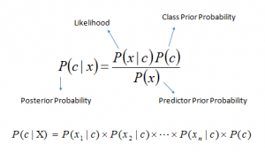
Naive Bayes
It is a classification technique based on Bayes’ Theorem with an assumption of independence among predictors. In simple terms, a Naive Bayes classifier assumes that the presence of a particular feature in a class is unrelated to the presence of any other feature.
Even if these features depend on each other or upon the existence of the other features, all of these properties independently contribute to the probability that this fruit is an apple and that is why it is known as ‘Naive’.

Slide 5
Naive Bayes
p(x₁, . . . , x₅₀₀₀₀|y) = p(x₁|y)p(x₂|y, x₁)p(x₃|y, x₁, x₂)· · · p(x₅₀₀₀₀|y, x1, . . . , x₄₉₉₉₉)
= p(x₁|y)p(x₂|y)p(x₃|y)· · · p(x₅₀₀₀₀|y)
= ∏^{n}_{i=1} p(xi |y)
to make a prediction on a new example with features x, we then simply calculate
p(y = 1|x) = p(x|y = 1)p(y = 1) /p(x)
= [∏^{n}_{i=1}p(x_{i} |y = 1) p(y = 1)] /[ ∏^{n}_{i=1}p(x_{i} |y = 1) p(y = 1) + ∏^{n}_{i=1}p(x_{i} |y = 0) p(y = 0)]

Slide 6
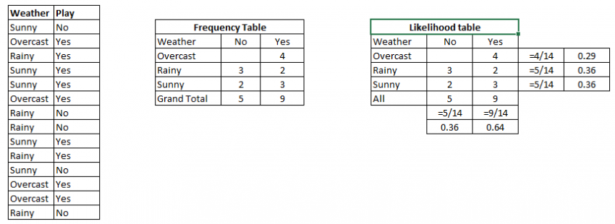
Example

Slide 7
Example
Problem: Players will play if weather is sunny. Is this statement is correct?
We can solve it using above discussed method of posterior probability.
P(Yes | Sunny) = P( Sunny | Yes) * P(Yes) / P (Sunny)
Here we have P (Sunny |Yes) = 3/9 = 0.33, P(Sunny) = 5/14 = 0.36, P( Yes)= 9/14 = 0.64
Now, P (Yes | Sunny) = 0.33 * 0.64 / 0.36 = 0.60, which has higher probability.

Slide 8
Pros and Cons
Pros:
It is easy and fast to predict class of test data set. It also perform well in multi class prediction
When assumption of independence holds, a Naive Bayes classifier performs better compare to other models like logistic regression and you need less training data.
It perform well in case of categorical input variables compared to numerical variable(s). For numerical variable, normal distribution is assumed (bell curve, which is a strong assumption).
Cons:
If categorical variable has a category (in test data set), which was not observed in training data set, then model will assign a 0 (zero) probability and will be unable to make a prediction. This is often known as “Zero Frequency”. To solve this, we can use the smoothing technique. One of the simplest smoothing techniques is called Laplace estimation.
On the other side naive Bayes is also known as a bad estimator, so the probability outputs from predict_proba are not to be taken too seriously.
Another limitation of Naive Bayes is the assumption of independent predictors. In real life, it is almost impossible that we get a set of predictors which are completely independent.

